Slide 1
The Determinators
Lancaster University Enterprise Challenge

Slide 2
Our team
Team coordinator
Finance
Cash-flow, Juan
Funding, Suhas
Research
Technology, Dami
Logistics, Patrick
Education, Simeon
Simeon

Slide 3
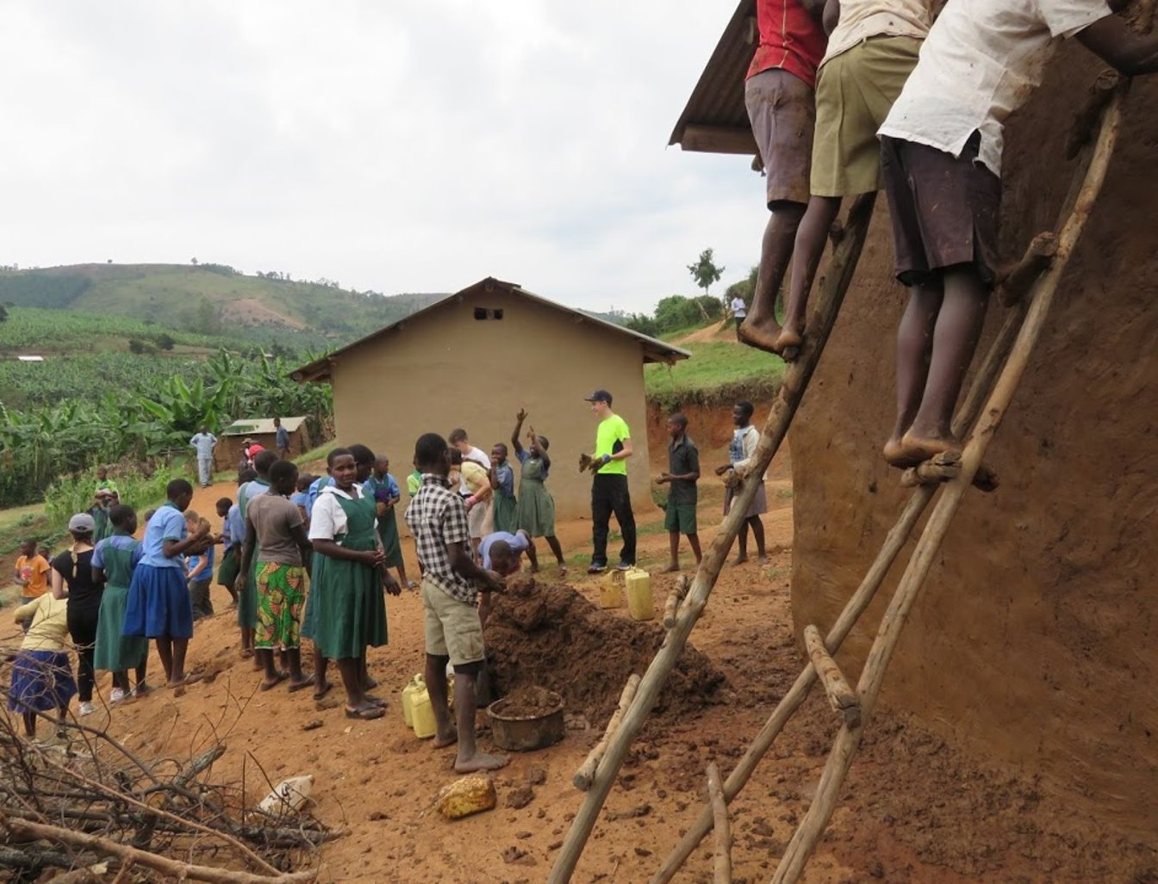
UN sustainability targets
Our selected United Nations’ Goals:
Main, 4: Quality education
Subsidiary, 7: Renewable energy
We decided to choose these two goals because:
By providing solar panels to local schools and communities we would help them become more sustainable
Our project promotes use of sustainability energy
Our school in Uganda

Slide 4
The general idea
During visits to Uganda we will place generators in rural schools
The generated electricity will power laptops, improving educational opportunities
This will reduce inequality of development between urban and rural schools

Slide 5
Why we chose Uganda
41% of the population lives in poverty
There is a disproportionate population pyramid
Much of the development done in Uganda focuses on cities rather than rural areas
Every 2 years our schools visits schools in Uganda
Schools in Fort Portal have minimal access to electricity

Slide 6
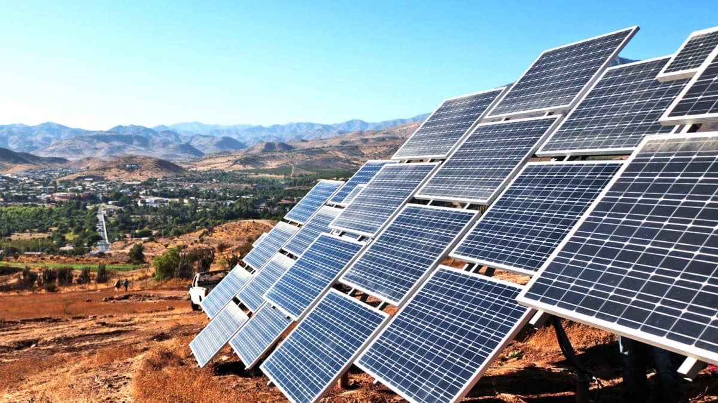
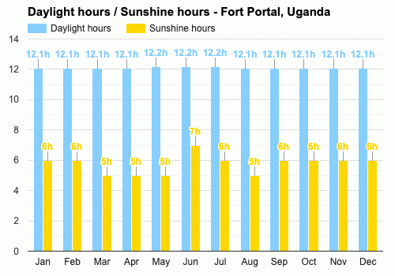
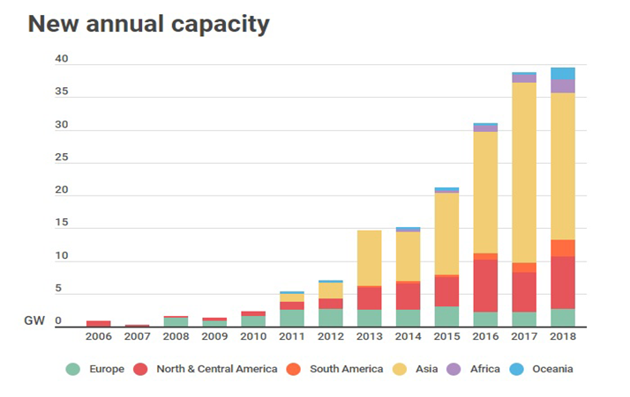
Energy sources
Our initial plan was to provide electricity to schools using enzymes to convert organic farm waste into biofuel
However we decided the availability of solar energy made it the most suitable form for Uganda
There were also ethical issues regarding the usage of farm waste in a country plagued by poverty
Shown by the graph, solar energy is an area that hasn’t been properly utilised in Africa
We hope to be a catalyst of the new age of energy!

Slide 7
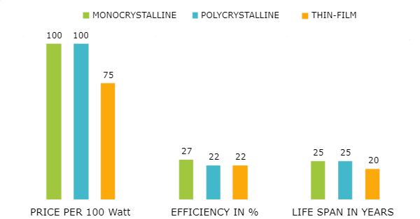
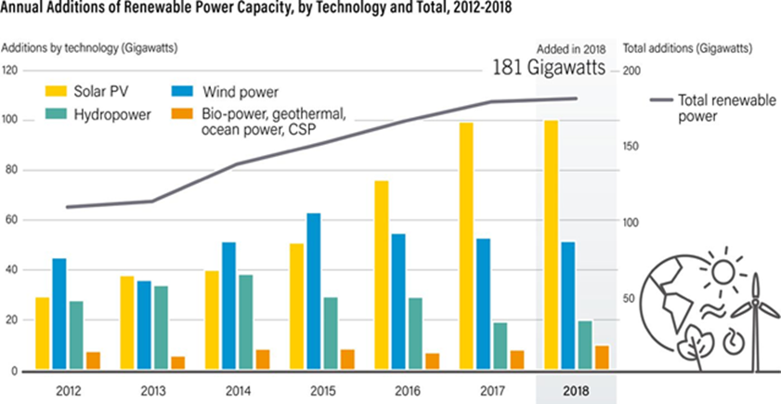
How the technology works
Solar energy is the most freely available source of energy in the world
Using monocrystalline photovoltaic cells, we will be able to harness and transfer this energy into electricity, for general use
The solar panels will be installed on school roofs allowing us to store the electricity generated in solar charge controllers and batteries

Slide 8
Scalability
Phase 1
We will install the solar electricity generators in 10 schools within 5 years
Phase 2
After 5 years employ full time installers/engineers and scale up to schools each rural district
Phase 3
Expand to the rest of Uganda and possibly to neighbouring countries such as Kenya, Malawi and Tanzania

Slide 9
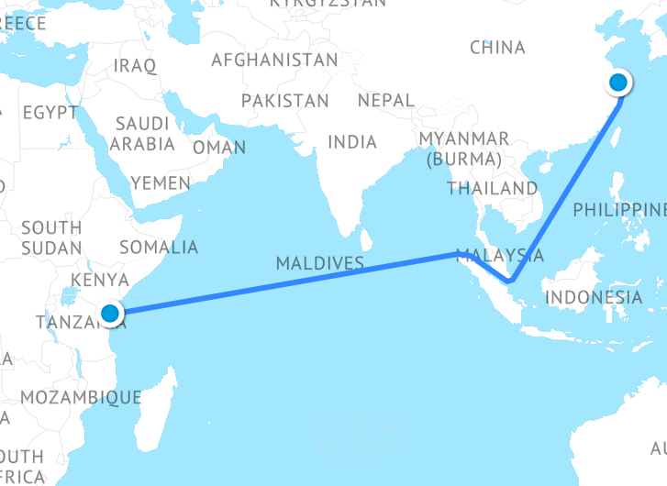
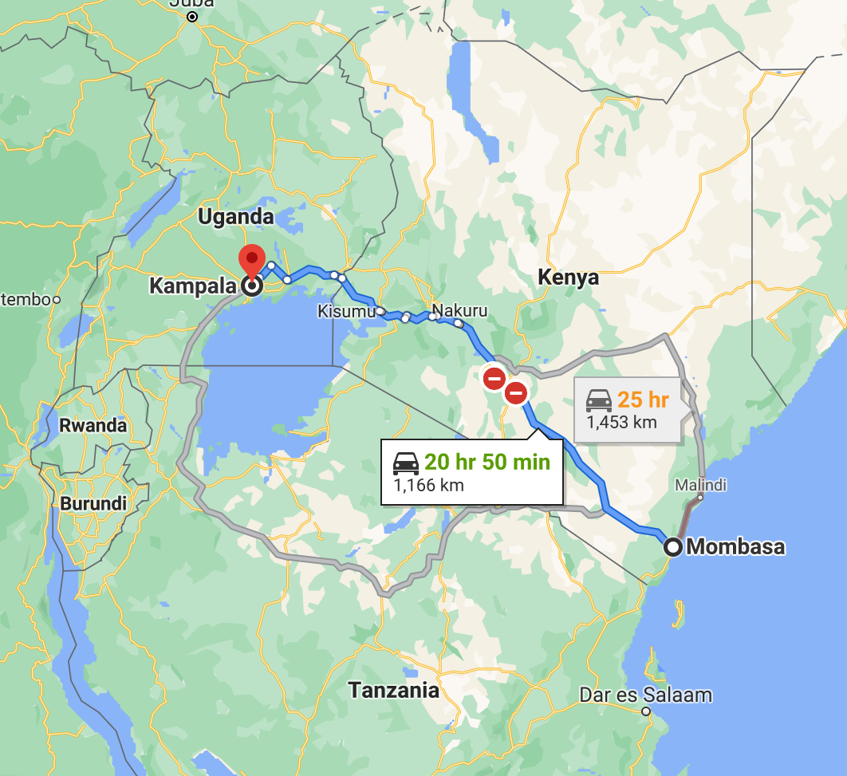
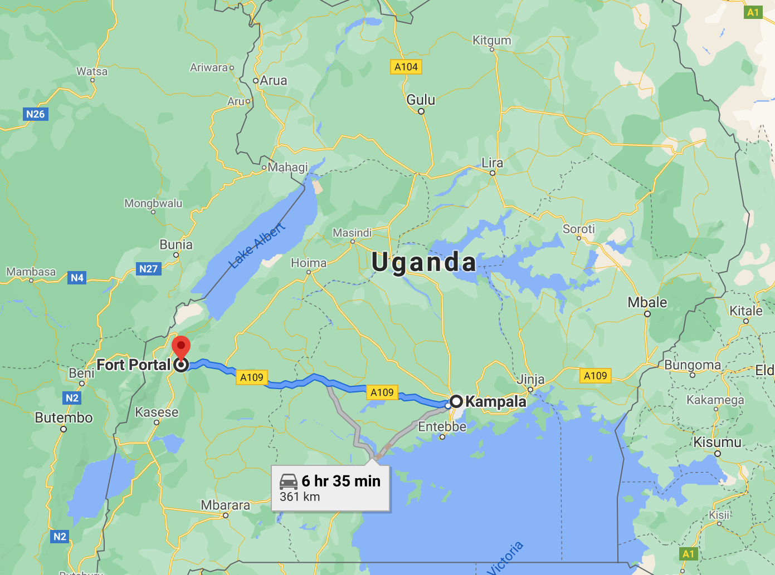
Logistics
1) Buy laptops, solar panels and batteries in excess from Alibaba, assuming some will be damaged - £24,000
2) Ship stock from Shanghai to Mombasa - £7,000
3) Using rental trucks, transporting stock from Mombasa to Fort Portal via Kampala - £2,000

Slide 10
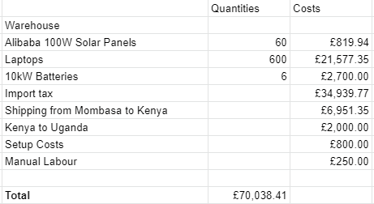
Initial Funding
Get a contract with established technology company for financial provision worth £150000 a year
Request overseas development agency grants (ODAs)
Get direct sponsorship by a UK school for Ugandan schools
Carbon offset schemes

Slide 11
Projected cash flow over first 5 years
Year 1
Year 3
Year 2
Year 4
Year 5
Will generate money for electricity sold at night for 1 year after installing, after which the schools have full ownership of the electricity
We will get an income and money towards university fees
Will reach 10 schools by end of year 5

Slide 12
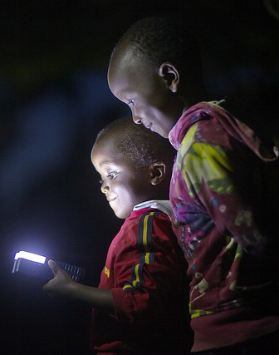
Summary
Meets goals 4 and 7
Provides life changing opportunities to deprived children
Reduces a large rural urban inequality of development in partner schools
Provides a sustainable source of energy
Spreads awareness of renewable energy
Can help foster links between UK schools and those in Africa with opportunities for direct sponsorship by a UK school and thus involve more UK school children as well

Slide 13
Thank you for your time and attention
We look forward to answering any questions
Finance
Cash-flow, Juan
Funding, Suhas
Research
Technology, Dami
Logistics, Patrick
Education, Simeon

